Slide 1
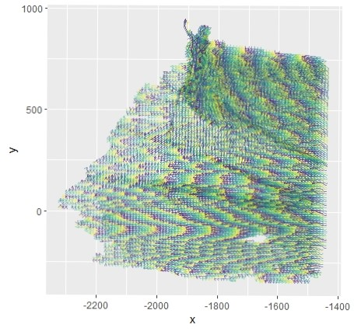
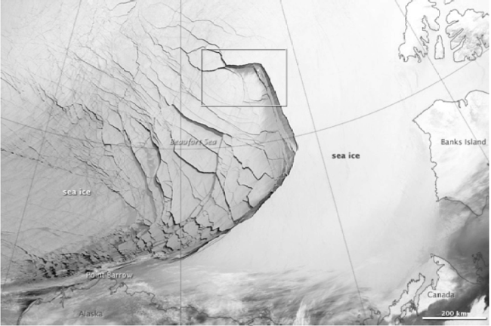
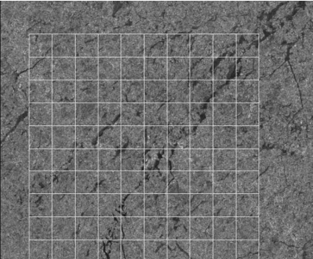
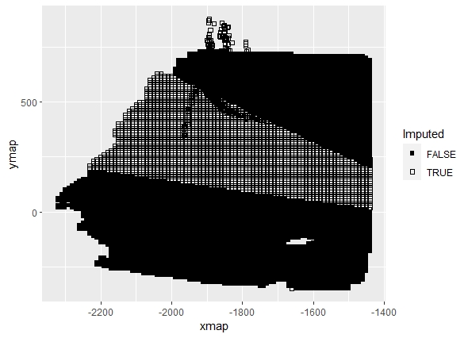
A Spatio-Temporal Model for Arctic Sea Ice
Alison Kleffner, Susan VanderPlas, Yawen Guan
Department of Statistics, University of Nebraska - Lincoln
Introduction
Sea ice is frozen water in the Arctic Ocean that generally occurs as an ice pack which can drift over the oceans surface Cracks, or leads, may form in the ice pack due to dynamic processes Allows for heat from the ocean to be transferred to the atmosphere Other Ice Lead detection methods through satellite images Thermal Images Deformation Calculations Satellite data can be low in resolution and are affected by atmospheric conditions (clouds, etc.)
Data
Used motion data from the RADARSTAT Geophysical Processing System (RGPS) The movement of sea ice is tracked in sequential radar images Due to this data collection, data may be missing
Method Motivation
Groups of movement patterns within the ice pack. Trajectories in the ice sheet can be grouped together when have similar movement.
1/4
Questions? akleffner@huskers.unl.edu

Slide 2
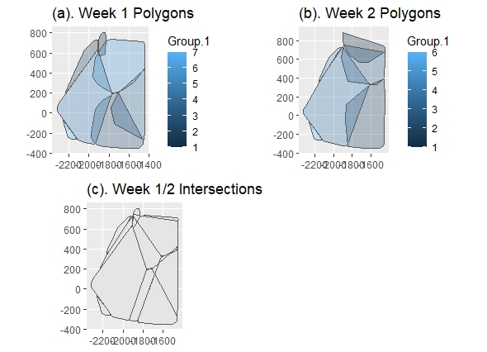
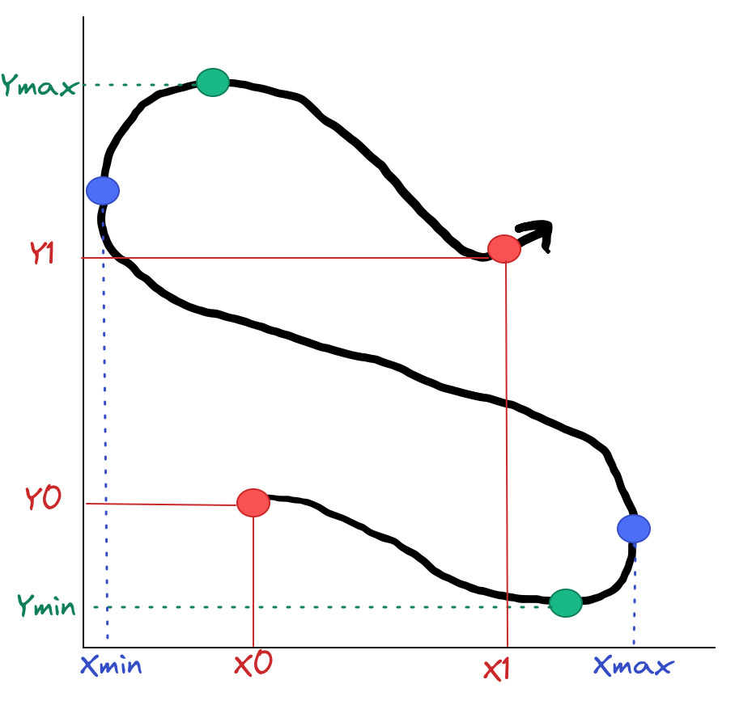
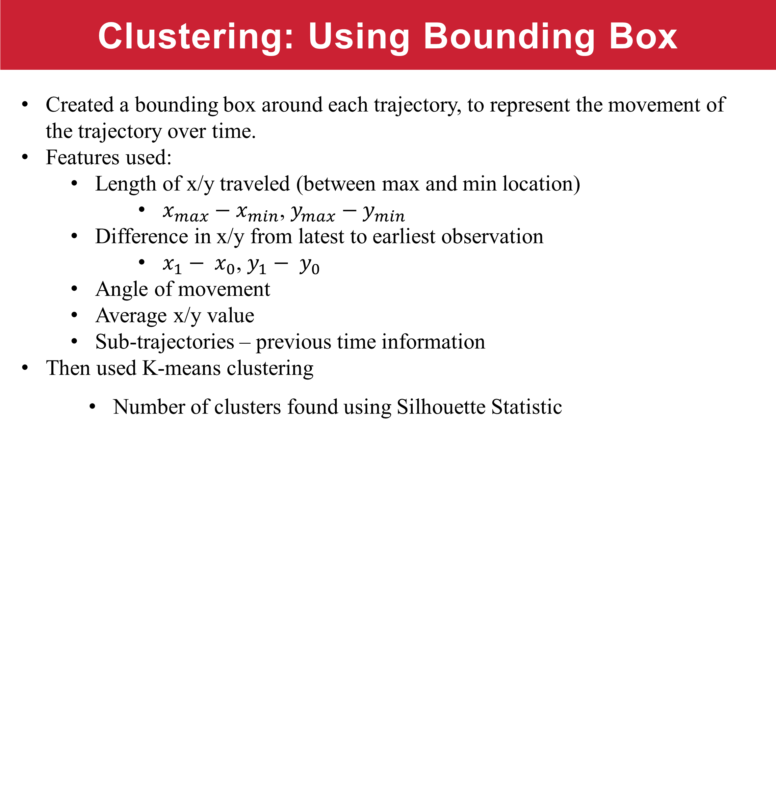
A Spatio-Temporal Model for Arctic Sea Ice
Alison Kleffner, Susan VanderPlas, Yawen Guan
Department of Statistics, University of Nebraska - Lincoln
Clustering: Using Bounding Box
Created a bounding box around each trajectory, to represent the movement of the trajectory over time. Features used: Length of x/y traveled (between max and min location) $x_{max}−x_{min}$, $y_{max}−y_{min}$ Difference in x/y from latest to earliest observation $x_{1}− x_{0}$, $y_{1}− y_{0}$ Angle of movement Average x/y value Sub-trajectories – previous time information Then used K-means clustering Number of clusters found using Silhouette Statistic
Spatio-Temporal Interpolation
Define the spatio-temporal neighbors for each missing point, using our previously made clusters Member of an intersection are considered spatio-temporal neighbors, because in similar geographic region over time. Created univariate models for x and y using the GpGp package in R, which uses the Vecchia’s approximation, using the exponential space-time covariance function. Output is the MLE of mean and covariance parameters. Use Model to predict missing locations and on the grid.
2/4
Questions? akleffner@huskers.unl.edu

Slide 3
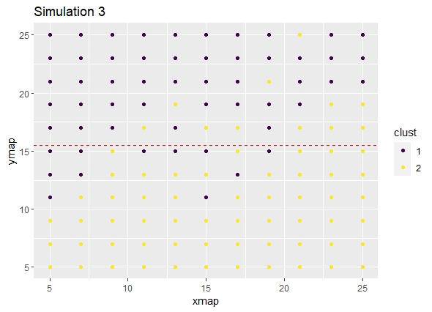
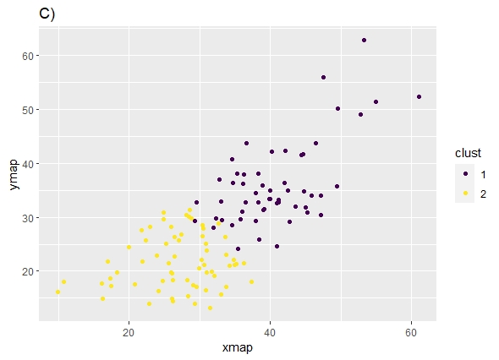
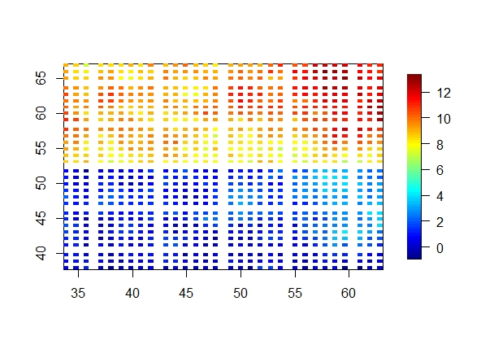
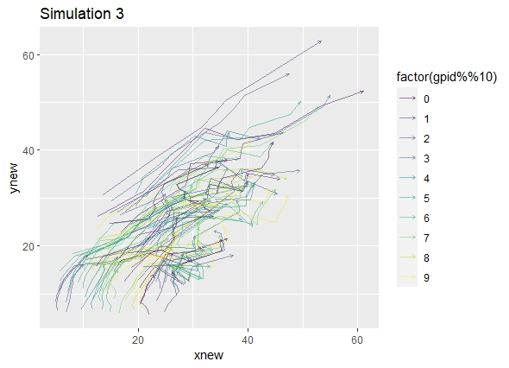
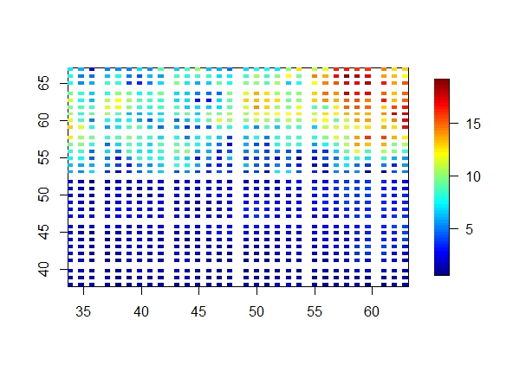
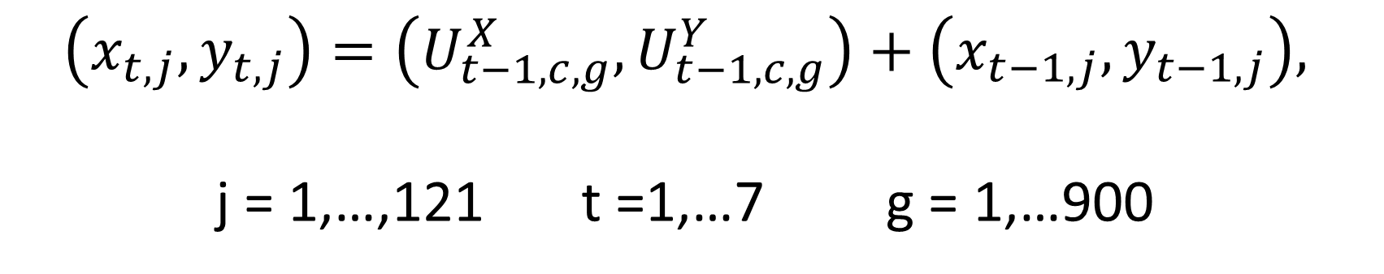

A Spatio-Temporal Model for Arctic Sea Ice
Alison Kleffner, Susan VanderPlas, Yawen Guan
Department of Statistics, University of Nebraska - Lincoln
Simulation Study
Generate Underlying Process: | 2. Generate Trajectories using Underlying Process | 3. Results
$$U_{d,c}\left(s,t\right)\sim GP\left(μ_{d,c},C_{d,c}\left(θ\right)\right),$$
$C_{d,c}\left(θ\right)=σ^{2}e^{−|\left|D^{−1}\left(x−y\right)\right||}$ ,
d=x,y c = 1,2
$$\left(x_{t,j}, y_{t,j}\right)=\left(U_{t−1,c,g}^{X},U_{t−1,c,g}^{Y}\right)+\left(x_{t−1,j}, y_{t−1,j}\right),$$
j = 1,…,121 t =1,…7 g = 1,…900
Movement in X
Movement in Y
RMSE for Interpolation Methods
 | Intersection Model |  | Linear Interpolation |  | No Intersection Model
 | X | Y | X | Y | X | Y
Overall | 1.388 | 1.304 | 2.7 | 1.83 | 1.441 | 1.493
Cluster 1 | 1.38 | 1.16 | 3.1 | 2.18 | 1.457 | 1.664
Cluster 2 | 1.402 | 1.53 | 1.39 | 0.35 | 1.423 | 1.261
3/4
Questions? akleffner@huskers.unl.edu

Slide 4
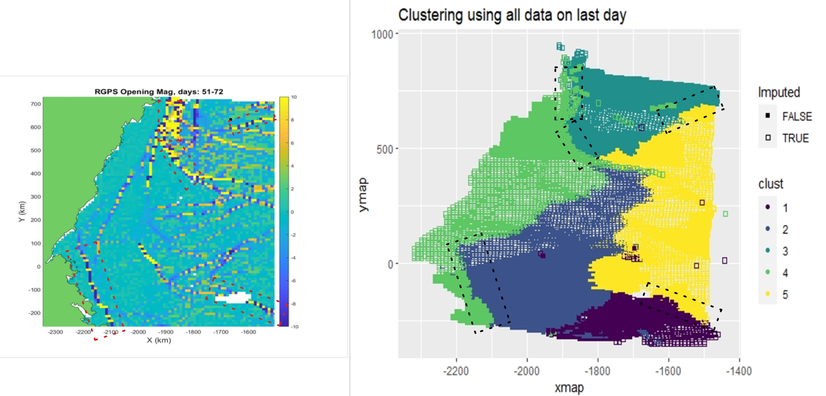
A Spatio-Temporal Model for Arctic Sea Ice
Alison Kleffner, Susan VanderPlas, Yawen Guan
Department of Statistics, University of Nebraska - Lincoln
Ice Data Results
Clustering: Interpolation Cross Validation : Used data in intersection from day before and day after to develop model Compared to Linear Interpolation, and running the model using all the data from the week (no intersections)
Conclusion
Bounding Box method is limited by pre-defined number of clusters, but seems to discover large ice leads. Should be used in conjunction with other ice lead detection methods Intersection Interpolation Method shows promise over linear interpolation when data is not linear. Some issues in model creation – like if not enough known data in that intersection for a given time, large temporal range, etc.
References
Guan, Yawen & Sampson, Christian & Tucker, James & Chang, Won & Mondal, Anirban & Haran, Murali & Sulsky, Deborah. (2019). Computer Model Calibration Based on Image Warping Metrics: An Application for Sea Ice Deformation. Jrnl of Agricultural, Biological and Environmental Statistics. 24. Guinness, J., & Katzfuss, M. (2021). GpGp: Fast gaussian process computation using vecchia’s approximation. Key, J., Stone, R., Maslanik, J., & Ellefsen, E. (1993). The detectability of sea-ice leads in satellite data as a function of atmospheric conditions and measurement scale. Annals of Glaciology, 17, 227–232. Peterson, K. and D. Sulsky (2011). “Evaluating Sea Ice Deformation in the Beaufort Sea Using a Kinematic Crack Algorithm with RGPS Data”. In: Remote Sensing of the Changing Oceans. Berlin, Heidelberg: Springer. Schreyer, H. L., D. L. Sulsky, L. B. Munday, et al. (2006). “Elastic-decohesive constitutive model for sea ice”. In: Jrnl of Gphys Research: Oceans 111.C11. Willmes, S. and G. Heinemann (2015). “Pan-Arctic lead detection from MODIS thermal infrared imagery”. In: Annals of Glaciology 56, pp. 29–37.
RMSE for Week 1 by Cluster
 | Intersection Model |  | Linear Interpolation |  | No Intersection Model
Cluster | X | Y | X | Y | X | Y
1 | 3.018 | 4.333 | 3.199 | 13.042 | 2.515 | 3.41
2 | 4.376 | 4.633 | 0.187 | 0.359 | 4.258 | 4.106
3 | 2.641 | 3.144 | 1.314 | 3.066 | 2.163 | 2.883
4 | 3.024 | 2.873 | 1.396 | 2.442 | 2.46 | 2.777
5 | 3.925 | 3.586 | 0.74 | 3.036 | 3.895 | 3.241
6 | 3.143 | 3.08 | 1.876 | 5.459 | 2.597 | 3.098
RMSE for Interpolation Methods
 | Intersection Model |  | Linear Interpolation |  | No Intersection Model
Week | X | Y | X | Y | X | Y
1 | 3.156 | 3.24 | 1.52 | 4.098 | 3.093 | 3.067
2 | 3.142 | 3.062 | 1.984 | 1.399 | 3.198 | 3.151
3 | 3.178 | 3.093 | 0.987 | 1.189 | 3.19 | 3.15
4/4
Questions? akleffner@huskers.unl.edu

